Slide 1
ADMe Overview 2021-Part-2

Slide 2
Job Scheduling
Methods of Job Initiation
Interactively on Demand
Command line
Avamar root CRON
External Scheduler
Networker NMC GUI
Notes:
Several choices are available for auto scheduling ADMe job policies. The actual call syntax regardless of the method used to initiate them are identical therefore it’s the trigger method that differs. The following pertains to both Standard and Batch policy initiation.
The syntax for starting a job policy is:
adme -batch job-policy-name
adme -BATCH job-policy-name
The case sensitivity of the –batch parameter is significant. If issued as lower case the command prompt will return immediately, using upper case it will return with an appropriate RC value only once a job has ended.

Slide 3
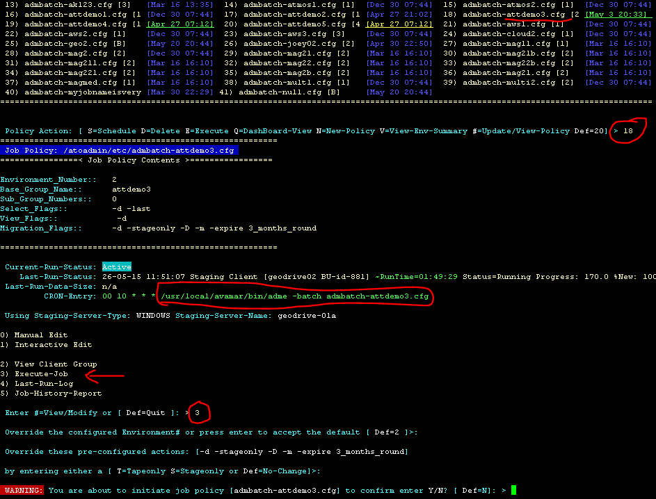
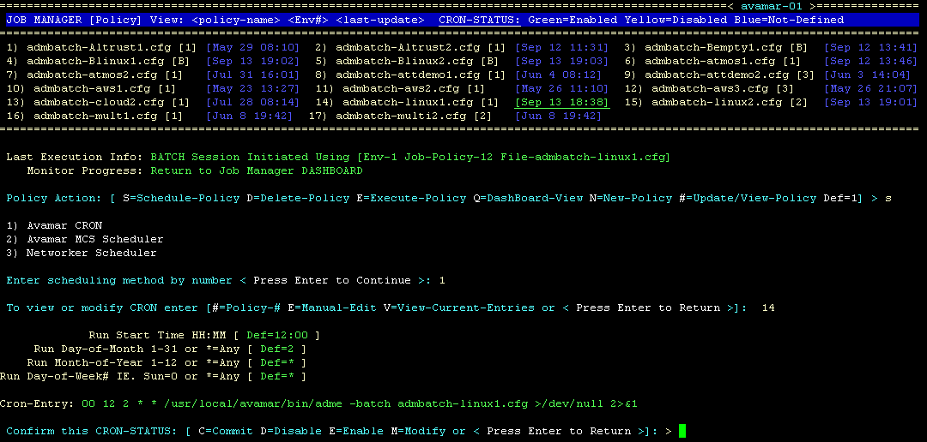
CLI-UI - Job Scheduling
Via Avamar CRON or Interactively
From Job Policy Manager – Policy View
Interactive job initiation
Notes:
Auto scheduling job policies relies on Avamar’s root CRONtab which is manipulated as required from either the Web-UI or CLI Menu. Its syntax and capabilities with respect to when, frequency of execution are those offered by the normal Unix/Linux CRON syntax.

Slide 4
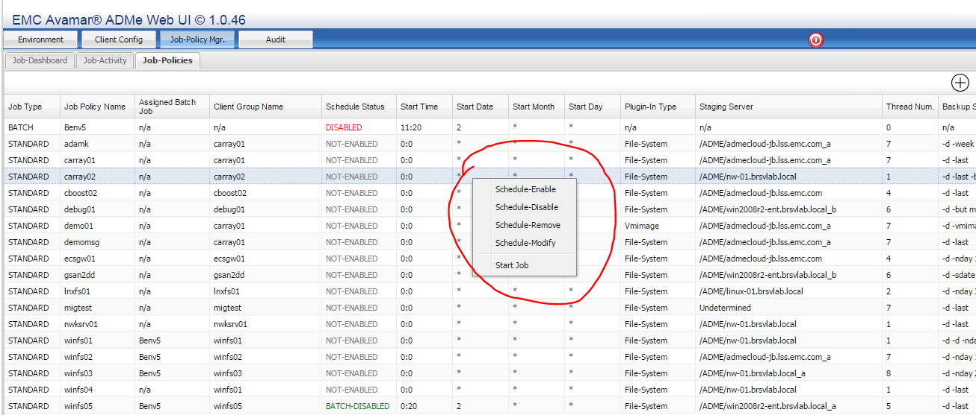
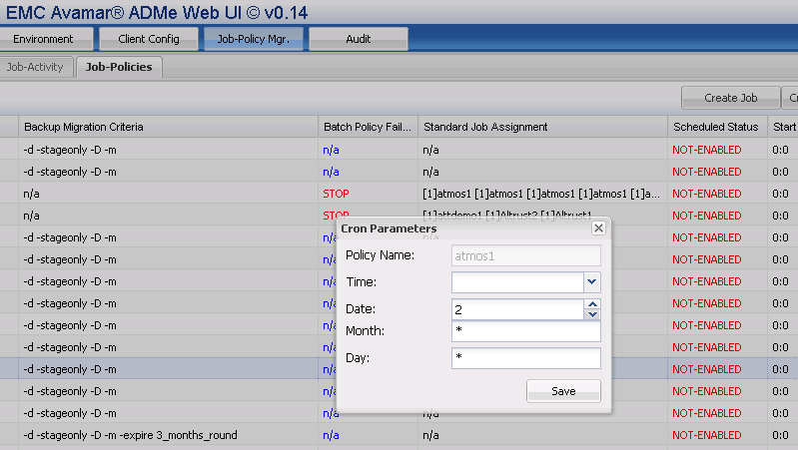
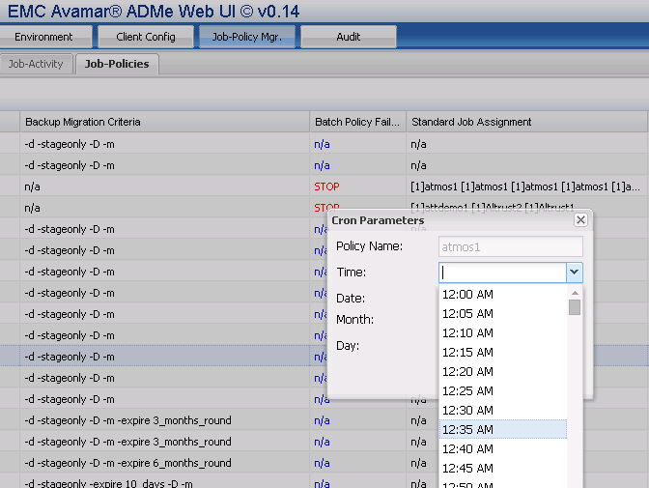
Web-UI - Job Scheduling
Via ADMe Web-UI or Interactively
Notes:
From the ADMe Web-UI Job-Policies tab highlight the desired row then right-click to display its context menu. Choose appropriate option to schedule a job by entering desired start date & time accordingly. Additional options exist for modifying an existing schedule, un-scheduling a job or temporarily disabling it from the scheduler while retaining its current start date & time to be re-enabled later.

Slide 5
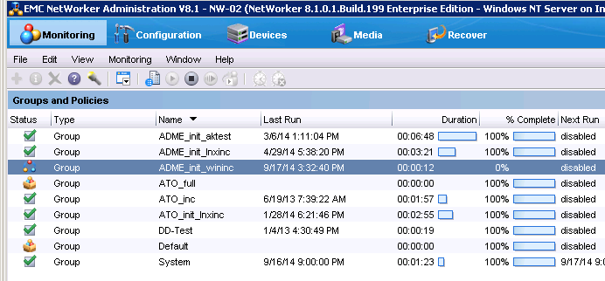
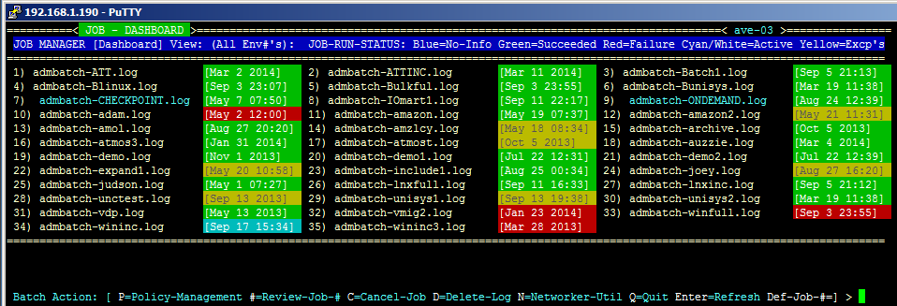
Job Scheduling Via Networker NMC-UI
1. Initiate an ADMe job policy directly from Networker Management Console
3. Upon completion status & run times will be reflected in NMC, ADMe Dashboard and GUI Job Activity panel with detailed job log info available from ADMe dashboard & GUI
2. It’s corresponding job policy goes active reflected by the date stamp displayed in cyan/white in Menu or to Running status in GUI
Notes:
Leveraging the Networker scheduler to trigger an ADMe job can be useful in situations where the end user is more comfortable and familiar with the Networker NMC console. The process will appear similar to a regular Networker job therefore can be scheduled via Networker’s own scheduler. It has been used to accommodate a customers Help Desk by allowing them to monitor run times and completion status of ADMe jobs in a manner similar to what they use to monitor their other Networker backups.
This process relies on Networker’s pre/post script calls referred to as PNPC call and is documented in the ADMe User Guide.

Slide 6


Slide 7
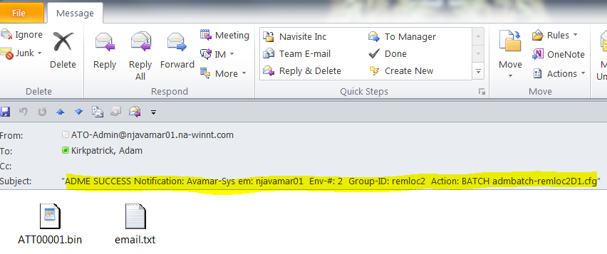
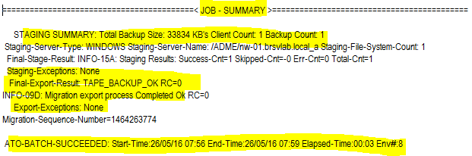
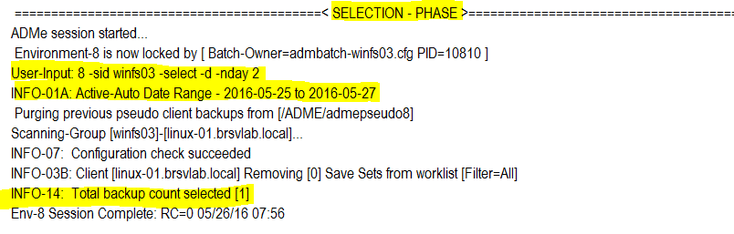
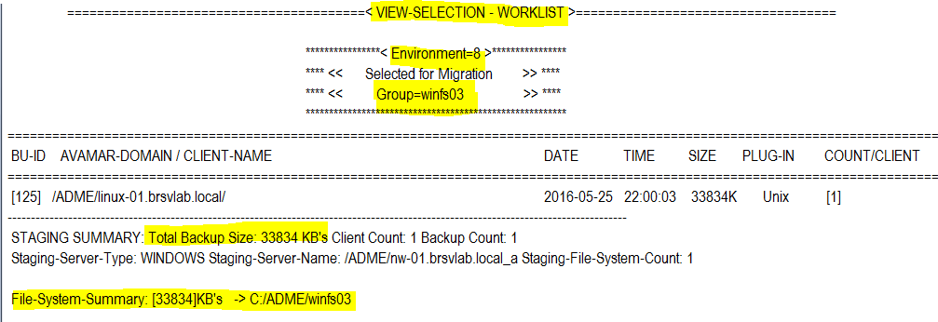
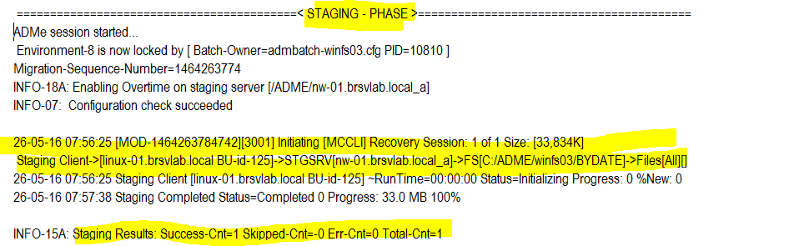
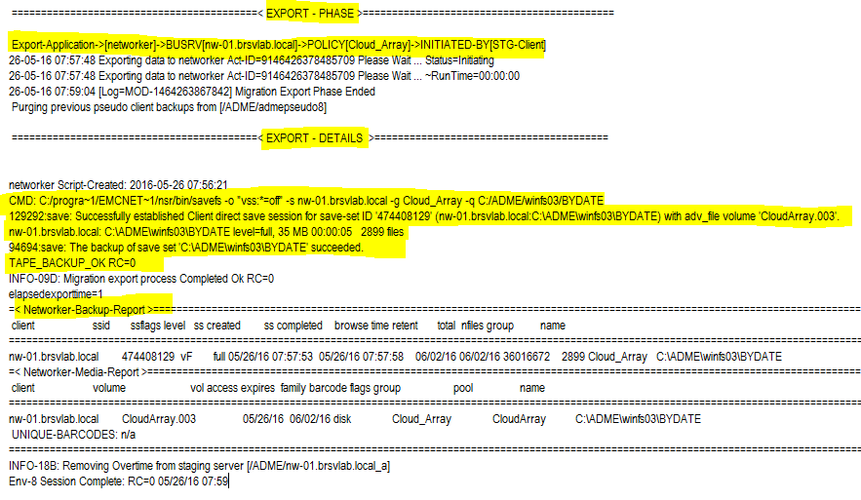
ADMe Mail Notification Content
Notes:
email notifications are automatically sent at the end of each job policy containing the status of all the migration phases. Their content is quite detailed enabling you to focus in on the primary cause of a failure. The mail content is presented in the body of the email but occasionally there may be non-displayable characters resulting in the mail system converting the body content to a .bin file attachment. To make it easier to read in this situation ADMe also attaches a .txt file of the email content.
Email notifications are sent to the mail address’s defined in the environment file being used by the job policy. There are two email address fields, the regular mail-to field will receive both success and error notifications while the mail-error field will receive only error notifications. The mail-error field is intended to coordinate with a customers help desk recipient who may record or open help tickets.

Slide 8
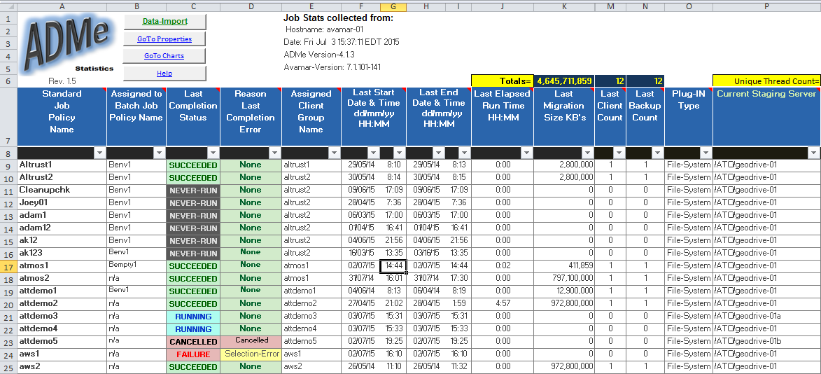
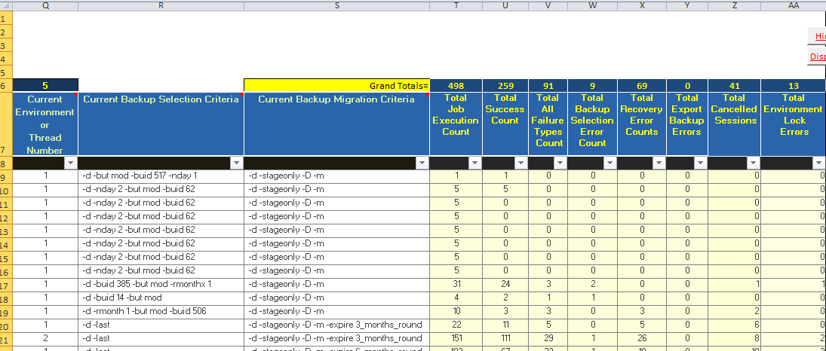
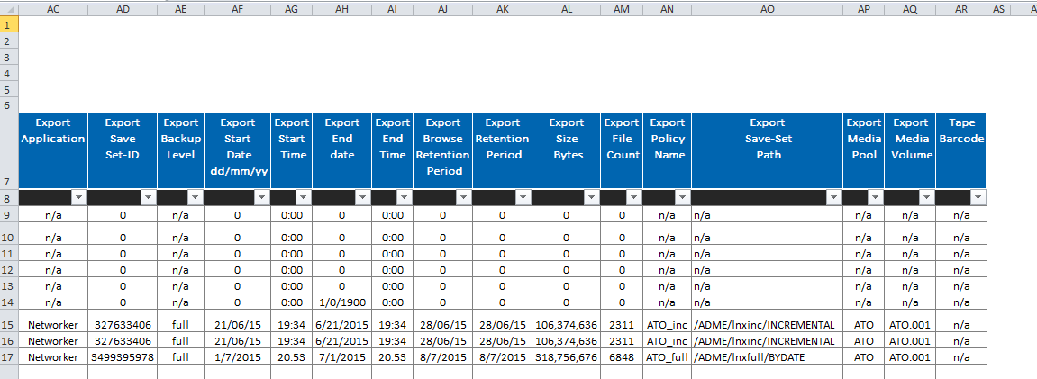
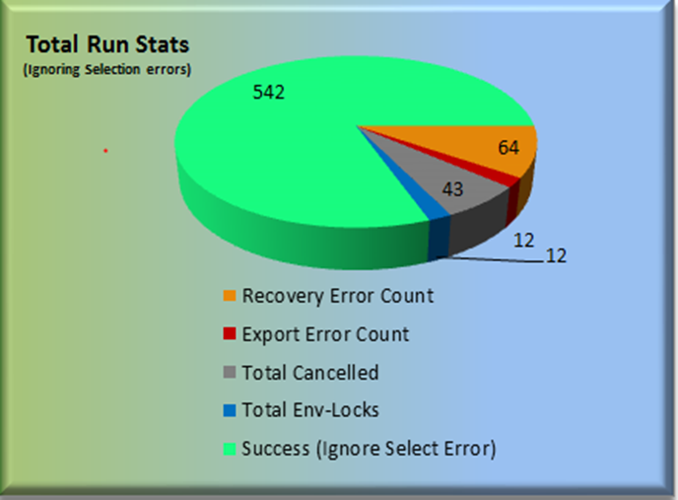
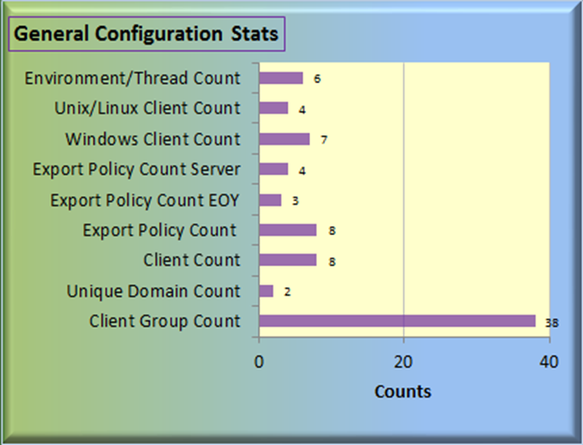
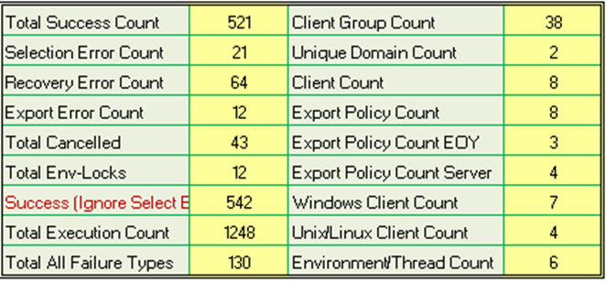
Job Stats Collection & Display
Stats collection process is quick and automated consolidating information into two CSV files which are emailed to you for import into a supplied customized spreadsheet
It matches displayed information in the Web UI Job Activity and Client Config tabs
Scroll-Right -> Job Parameters & Statistics
Scroll-Farther-Right -> Networker Meta Data Information
Notes:
ADMe job statistics can be ported to a custom spread sheet for portability of reporting on the all jobs completion status. Results are stored in two csv files and along with the supplied custom spreadsheet can be emailed by clicking on the mail icon in upper right corner of the Job-Activity tab. The csv files must be saved to a desktop which has Excel installed into a folder named C:\ADME in order for the built in macros to locate them when importing the csv file contents.
This spreadsheet is a necessity when ADMe is used to migrate ADS data to a new system with Data Domain to provide the cross reference details reflecting the migration completion status and date/time along with the ADMe backup selection dates used. These are the necessary metrics needed to locate the date/time within the target Avamar Restore GUI calendar of the backup which now represents the migrated data.

Slide 9
Staging to Cloud or Object Storage
Requires a compatible cloud gateway, the following have been verified with ADMe
  EMC CloudBoost, EMC CIFS-ECS and 3rd party TNT drive from Amazon and Cloudberry Drive
  Numerous other 3rd party products exist but not verified with ADMe
A gateway traverses the gap between legacy and object storage providing OS level access to the cloud storage from a Windows or Linux staging servers or optionally indirectly via Networker where the defined backup target media is cloud based
ADMe recoveries can be performed to a cloud enabled staging path when presented via CIFS, NFS, iSCSI or Windows virtual drive letters. NFS requires squash_root_hash disabled.
Cloud GW’s may leverage a local disk as cache space consumed initially until files have been uploaded to the cloud
  Cache improves front end staging performance
  Cache contributes to robustness of using cloud storage masking communications between GW and the Cloud
  CIFS-ECS optionally converts file names to stub files in the cache providing a quick and visible confirmation a file has been uploaded
Cloud GW’s effectively can provide infinite staging capacity to ADMe
Data Lifecycle Management
  ADMe->CIFS-ECS direct can leverage ECS retention policies managed within ECS
  ADMe->Networker->CB relies on Networkers lifecycle management
  ADMe direct dataflow can leverage ADMe’s own lifecycle management using its –expire option
Notes:
ADMe can stage backup data to cloud or object storage directly or indirectly. Indirect would rely on a tape application such as Networker which is configured with an ADVFD to store the migrated backup on a cloud based target device. Stored Directly would imply the staging disk used is a cloud enabled disk therefore only the staging phase would be required by ADMe.
In either case a compatible gateway must be used to provide the link between the staging server or Networker instance to the cloud or object storage. From ADMe’s perspective it has no explicit knowledge if cloud storage is being used or not. A cloud gateway would need to present the cloud storage using a OS compatible protocol such as CIFS, NFS or iSCSI all of which Avamar backups can be recovered to.
When uploading files to cloud storage in a deduplicated format which would be a feature of the cloud gateway it becomes impossible to leverage any cloud providers lifecycle management capabilities as the cloud is aware only of the dedupliacted chunk data not the logical files. When using a gateway such as CIFS-ECS or EMC GeodDrive files which do not support deduplication their original logical format is maintained therefore you can leverage any cloud based functionality for managing retention, read only and even to make files immutable assuming the object storage involved supports it.
By refraining from using deduplication of data in the cloud it will consume more storage but it greatly simplifies retrieval from the cloud as there are no specific dependencies on Avamar nor the GW in order to retrieve a file making it a good choice for LTR data.

Slide 10
ADMe Cloud Related Workflows
EMC GeoDrive
EMC CloudBoost
3rd Party GW’s
Notes:
The above Cloud gateways are all from EMC and have been verified to work satisfactorily with ADMe.
All aspects of using similar 3rd party Cloud gateways would be the responsibility of the user.

Slide 11










Export via GeoDrive Workflow
Avamar Server
(ADS or AV/DD)
Direct Workflow
Staging Server
Desktops
Laptops
Avamar Client
ROBO
WAN/LAN
CIFS-ECS Cache Disk
CIFS-ECS
Virtual Drive Letters
Files
NAS/NDMP
DB
Cloud
Export
VMware &
Hyper-V
Databases
EMC ECS via S3 API
Email
Applications
Technologies Legend
Geo-Drive
Avamar
Notes:
This workflow staging directly to a Windows based GeoDrive drive letter where migrated data is handled one time by ADMe. File data lands initially in a local disk area cache from where GeoDrive automatically uploads the data files to the cloud object store.
Each GeoDrive virtual drive letter can be authenticated to different ECS object stores each using different ECS account credentials. GeoDrive can leverage ECS retention capabilities for purposes of protecting data from being altered and to automate retention policies having them managed within ECS itself.
This product is free to any ECS customers and is simple to use.

Slide 12
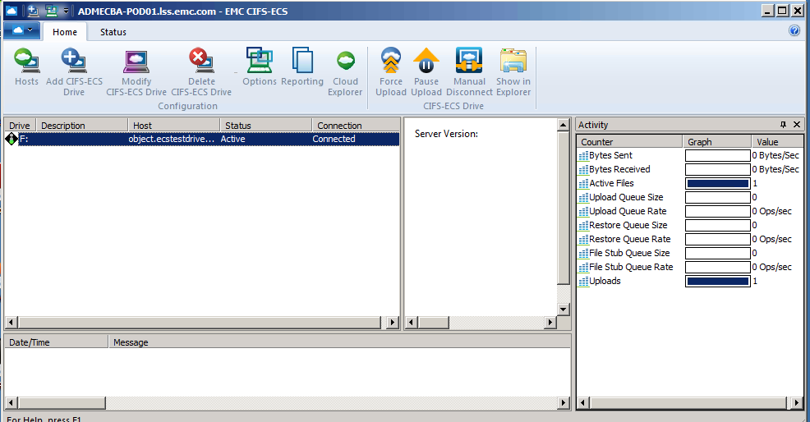
Geo-Drive UI
GeoDrive provides a REST based gateway from Windows to Dell EMC ECS object storage
The presence of GeoDrive is transparent to Avamar and ADMe
Can leverage ECS retention features
Synchronization stats visible during the synchronization process
Log provided documenting any files which failed to upload
Supports multiple enabled CIFS-ECS drive letters
GeoDrive contents uploaded to ECS, requires no local protection of associated stub files
Notes:
This screen shot showing the GeoDrive ECS user interface. Refer to its specific documentation for further details.

Slide 13
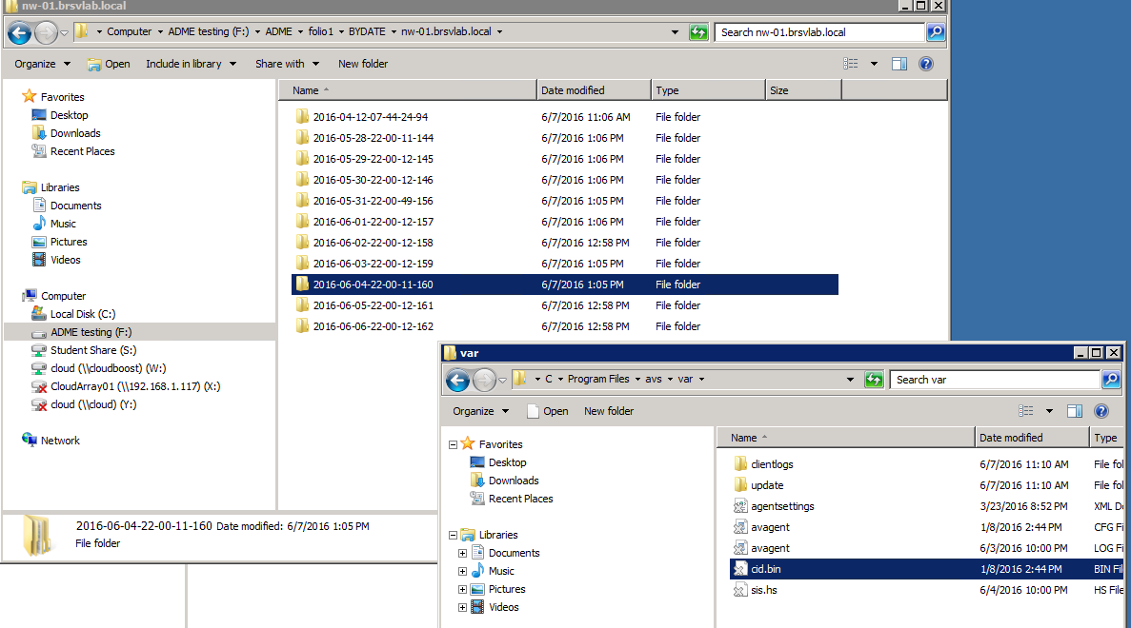
LTR Staging Hierarchy to Cloud Storage
(CIFS-ECS shown)
Includes original Avamar source client name staged by ADMe
User defined and structured top level folder(s)
Includes original Avamar backup date/time information
Sample of staged data to a Geo-Drive Drive-F
Uploaded files optionally leaves behind a stub file indicated with an X over its icon
Recoveries accomplished using double-click , copy/paste, drag/drop or 3rd party products such as S3 Browser
Note: ADMe is responsible for laying down the files only
Notes:
When using GeoDrive a visible indicator is provided to identify filenames which have been uploaded. Once a file is uploaded the Windows Offline X is displayed over the file icon. Note: only files have this indicator not directories. By default CIFS-ECS removes the file from its local cache disk replacing it with a stub file thereby reclaiming its capacity in the cache.
Recovering a file is accomplished using standard Windows explorer such as copy paste, drag and drop or simply double clicking the file involved. Since the stored files are not de-duplicated or compressed, it is possible to leverage various cloud browsers such as S3 Browser a 3rd party free shareware to access the files using appropriate authentication credentials.

Slide 14

Export via Cloud Boost Workflow
In-Direct
Workflow
Via Networker
Avamar Server
(ADS or AV/DD)
Networker
Staging Server
Desktops
Laptops
Avamar FS Client
ROBO
WAN/LAN
Local ADMe staging disk file systems
Files
NAS/NDMP
Networker backups directed to CB based Networker adv_file device
Networker 64 Bit Linux
FS Client
DB
VMware &
Hyper-V
Databases
Cloudboost
VM Appliance
Networker SN
Cloud
Export
Email
Applications
Technologies Legend
S3 Compatible Object Store
Atmos, ECS, S3, vCloud Air, etc
Maginatics
Avamar
Notes:
Two workflows are shown,
CB direct relies on the MagFS or Cloudboost agent installed on a Windows staging server. This approach with CB is no longer supported.
CB indirect relies on a Networker backup being performed and directed to a CB device defined to it
The Networker workflow is similar to doing regular tapeout however rather than writing to tape or DD the Networker target device is now replaced with a Networker CB device established to the CB appliance. Local staging disk is still required to hold the staged data.
Recoveries and lifecycle management are accomplished in the normal manner via Networker.

Slide 15
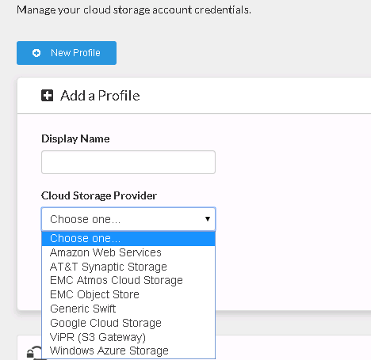
Supported Cloud Providers
For Cloudboost
Notes:
This slide documents the cloud providers supported by Cloud Boost.
Note: GeoDrive currently supports EMC ECS only
Although CB supports the various cloud providers shown only one can be used at a time. If you choose to switch to a different provider you will lose access to data stored to the current provider.

Slide 16
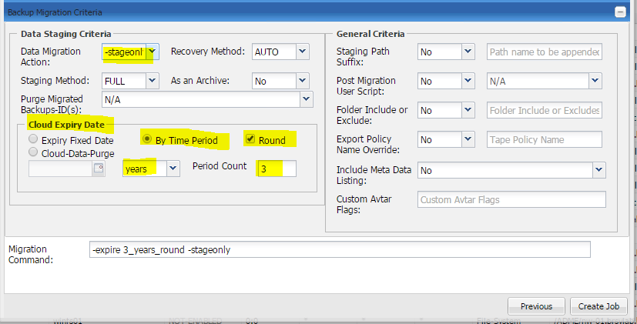
Cloud direct workflows offer limited lifecycle management capability
ADMe provides some structure around this with its –expire option
Insert anywhere in the top level staging path the keyword EXPIRE
ADMe calculates the specified retention period converting the EXPIRE keyword to folder name formatted as YYYY-MM-DD
Provides a visible indicator of the intended retention period with no inherent dependencies on ADMe or Avamar
Notes:
The –expire option looks for the keyword EXPIRE within the staging path field of a ADMe client group which is automatically converted into a date format YYYY-MM-DD representing the users defined retention period taken from parameters passed in a job policy definition. This results in a folder within the staging path representing the intended retention period of the data residing under this folder.
The round option when checked will round up the day value to the 1st of the next month of the defined retention period thereby reducing the number of top level expire date folders created by consolidating them under a given common folder covering an entire months set of migrations.
ADMe provides a special job function –clouddatapurge which scans for eligible expiry date folder structures deleting them when appropriate but it supports a CIFS share only and was added to support CloudBoost direct workflow which is no longer supported therefore this option is now considered deprecated.

Slide 17
Considerations to Using
Cloud Gateways with ADMe
Incremental staging does not result in a recall of previously staged files assuming stub files exist or the gateway provides a dedicated cache space
All cloud uploads and synchronization activities are handled by the gateway involved not ADMe
The staging server does not own the files uploaded to the cloud, but can be used to provide visibility and access to them
ATMOS & ECS offers layers of user access control and retention management against contents stored using GeoDrive
Security of uploaded data is accomplished by restricting access to the cloud based volumes
File recovery from a direct based workflow is accomplished using standard OS based file system tools
  Drag / Drop
  Copy / Paste
  Presenting a cloud volume to the host where the contents are needed
  Standard OS based file search's or the use of 3rd party search tools can be used against a cloud volume
File recovery from a indirect workflow is accomplished from the export applications Recovery UI
Data retention with an indirect workflow is accomplished by the export application used
Data retention with a direct workflow approach is accomplished by the user
  ADMe expiry option provides a visible top level folder YYYY-MM-DD to indicate the intended purge date
  This visible approach has no dependencies on ADMe or Avamar therefore practical for long term retention periods

Slide 18
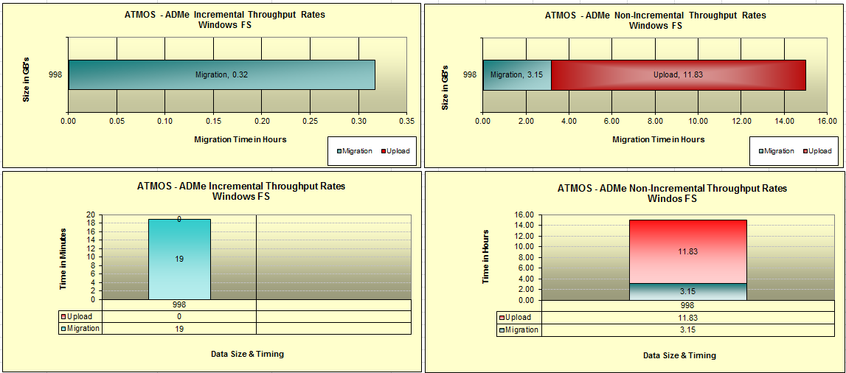

ECS/ATMOS
Throughput Stats
Via Internet to ATT Synaptic
Via Geo-Drive or CIFS-ECS
Notes:
Sample 1 TB job execution directed to ECS using CIFS-ECS gateway. Right hand side demonstrates the run time associated with staging non-incrementally while the right hand side demonstrates the run time for the same 1 TB backup when staged incrementally once the incremental baseline has been established.

Slide 19
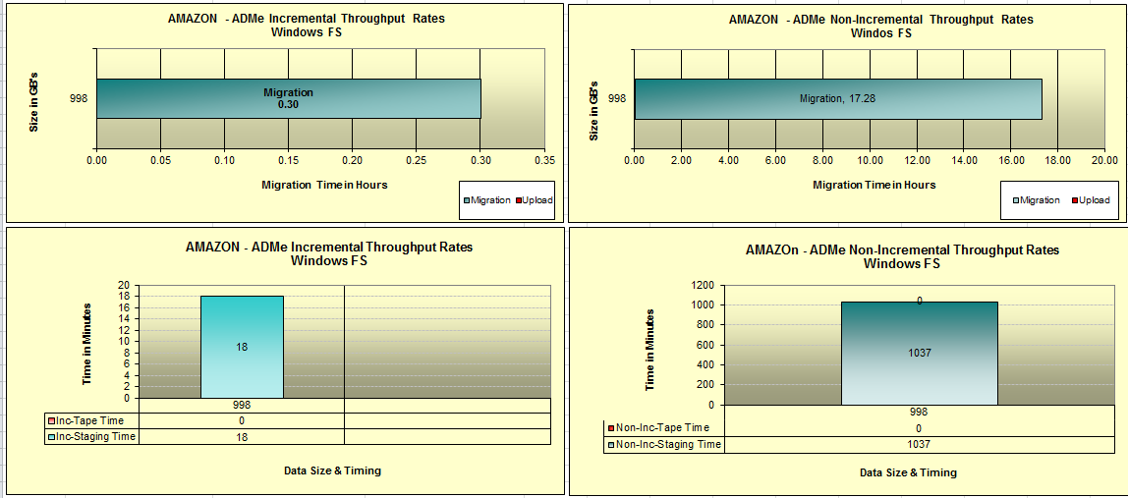
Amazon-S3
Throughput Stats
Via Internet to Amazon
Via TNT-Drive
Notes:
Sample 1 TB job execution directed to Amazons S3 storage using Amazons TNT Drive gateway. Right hand side demonstrates the run time associated with staging non-incrementally while the right hand side demonstrates the run time for the same 1 TB backup when staged incrementally once the incremental baseline has been established.

Slide 20
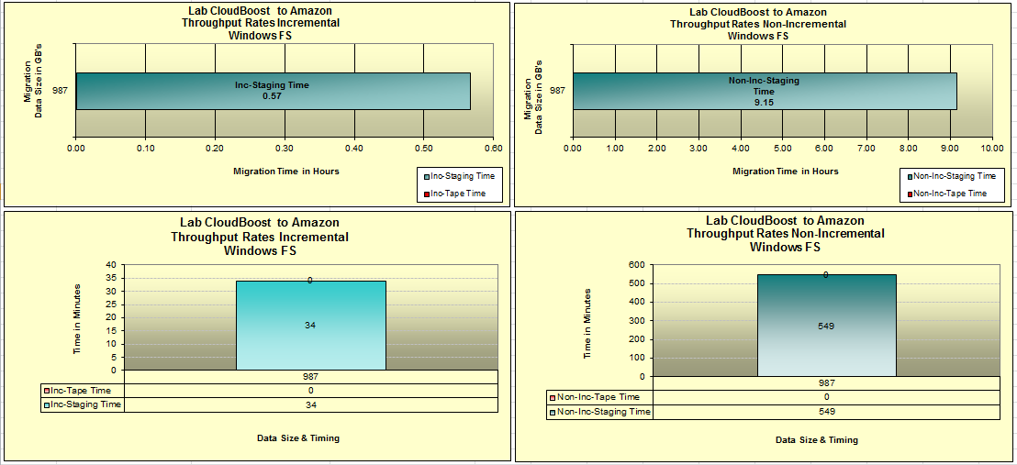
Amazon-S3
Throughput Stats
Via Internet to Amazon
Using Cloudboost
Notes:
Sample 1 TB job execution directed to ECS using CloudBoost as a direct gateway. Right hand side demonstrates the run time associated with staging incrementally once the incremental baseline has been established while on the right demonstrates the run time for the same 1 TB backup when staged non-incrementally.
Note: The use of CloudBoost direct agent to Windows is no longer supported by CB or ADMe.

Slide 21

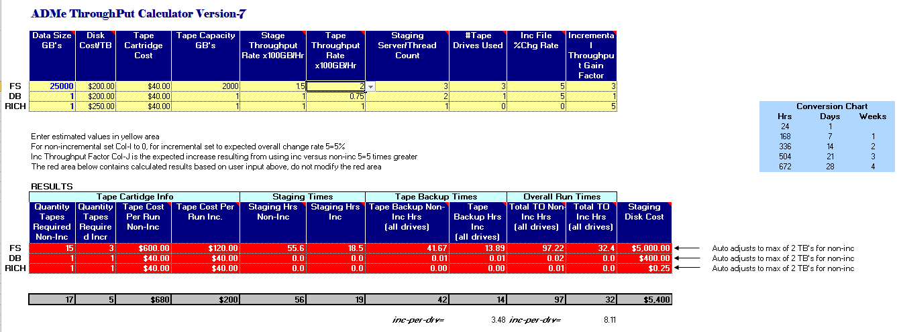
ADMe Sizing Tool
Enter expected throughput rates in yellow area to view expected runtimes in red area
Notes:
This is a screen shot of an Excel based ADMe calculator tool useful in providing ballpark run time figures. You must provide the expected staging rates and tape write phase throughput rates. By changing these values and the number of threads used one can get a feel for how long the migration process will take.
Conservative values to use would be as follows:
Staging Rate: 75-100 GB/Hr/Thread
Tape Backup Phase: 100 GB/Hr/Thread
using Networker PSS feature this value could be in the range of 200-400 GB/Hr
High density file system where file counts are in the millions will perform less.

Slide 22
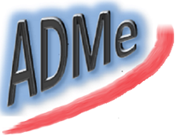
Supplemental Material Download
ADMe Supplemental Material - Landing Page
Google or Bing search for: adme migration
Look for page located on Dell/Community page
Notes:
All ADMe related material and latest code build levels can be found at the above link.
Always check this site for latest ADMe patch builds before an installation and use the latest patch build.

Slide 23


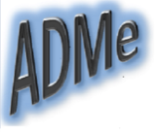













Thank You

Slide 24






Thank You

